Slide 1
ECE 465
Digital Systems Design
Fall 2023
Adder Architecture Comparisons
Using Verilog Simulation
Joseph Latocha

Slide 2
Motivation
Digital system addition is a fundamental function of most computing systems.
Many different kinds of adder architectures make it an interesting topic of investigation.
Every architecture has its pros and cons.
Develop a deeper understanding of coding in Verilog, and investigate the trade-offs in each of the adder architectures.
At the beginning of the semester, I had very little understanding of Verilog, and I wanted to know how I could use Verilog for testing my own future designs to continue my own designs and test these designs on an FPGA.

Slide 3
Problem Statement
Goals:
To investigate a variety of adder architectures using Verilog and detail their real-world implementation strengths and weaknesses.
Ripple-Carry Adder,
Carry-Lookahead Adder,
Parallel Prefix,
Kogge-Stone
Observe propagation behavior with active clock.
Investigate architectures’ simulation times (clock-cycles) and complexity.
Ensure adder correct calculation operation for each adder architecture.

Slide 4
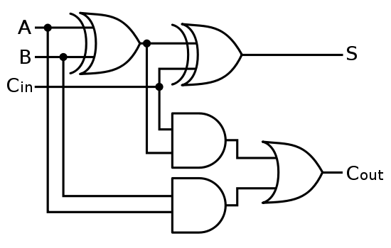
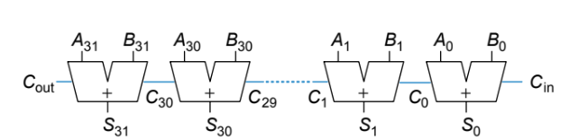
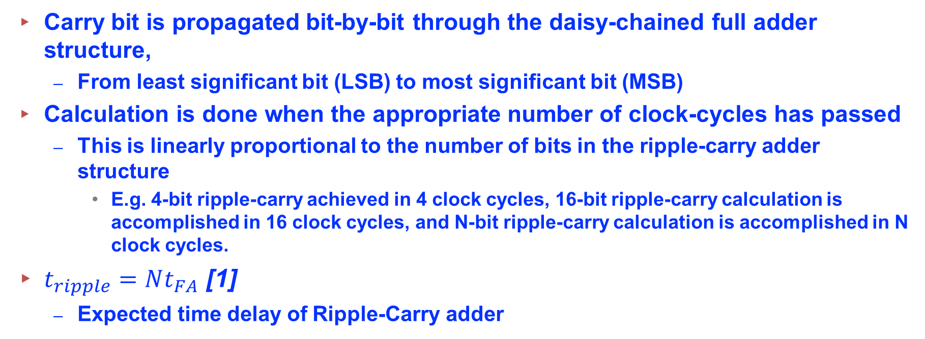
Techniques – Ripple Carry
Carry bit is propagated bit-by-bit through the daisy-chained full adder structure,
From least significant bit (LSB) to most significant bit (MSB)
Calculation is done when the appropriate number of clock-cycles has passed
This is linearly proportional to the number of bits in the ripple-carry adder structure
E.g. 4-bit ripple-carry achieved in 4 clock cycles, 16-bit ripple-carry calculation is accomplished in 16 clock cycles, and N-bit ripple-carry calculation is accomplished in N clock cycles.
$t_{ripple}=Nt_{FA}$ [1]
Expected time delay of Ripple-Carry adder
Figure 2: 32-Bit Ripple-Carry Block Diagram [1]
Figure 1: 1-Bit Full Adder Circuit [2]

Slide 5
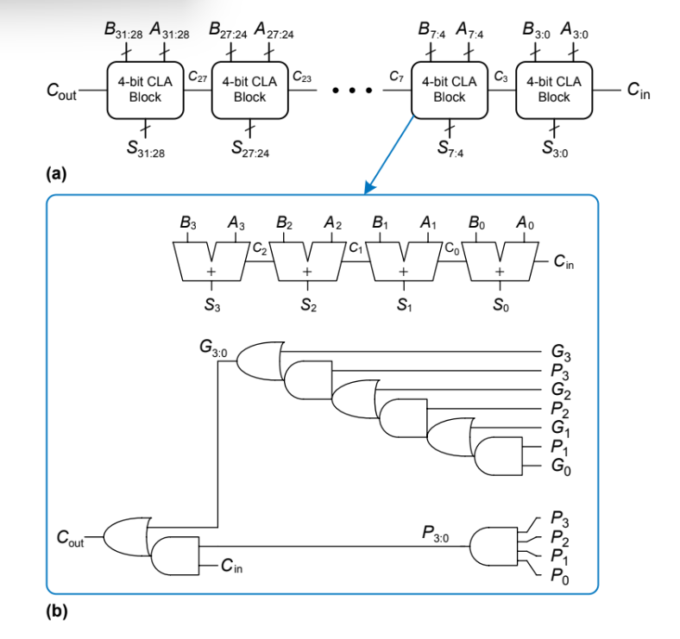
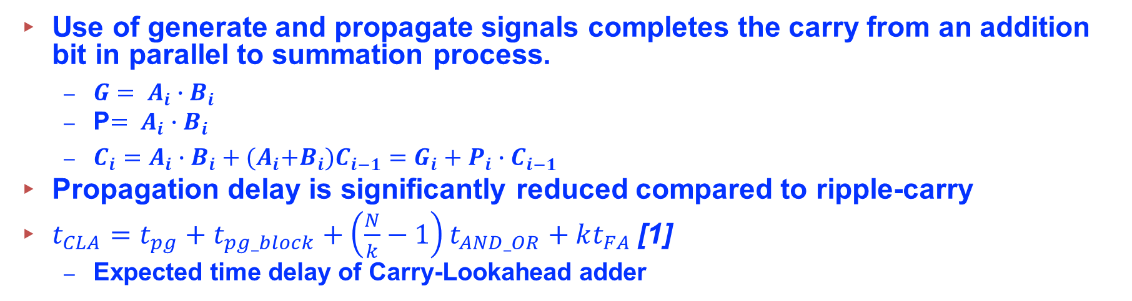
Techniques – Carry Look-Ahead
Use of generate and propagate signals completes the carry from an addition bit in parallel to summation process.
$G= A_{i}∙B_{i}$
P$= A_{i}∙B_{i}$
$C_{i}=A_{i}∙B_{i}+{(A}_{i}+B_{i})C_{i−1}=G_{i}+P_{i}{∙C}_{i−1}$
Propagation delay is significantly reduced compared to ripple-carry
$t_{CLA}=t_{pg}+t_{pg_block}+\left(\frac{N}{k}−1\right)t_{AND_OR}+kt_{FA}$[1]
Expected time delay of Carry-Lookahead adder
Figure 3: a)32-Bit Carry-Lookahead Block Diagram
b) Enlarged Image of 4-bit CLA Block [1]

Slide 6
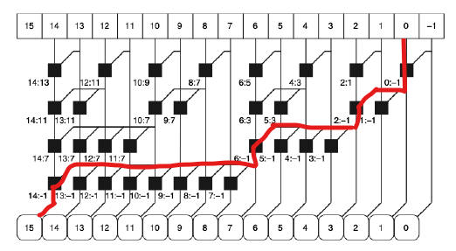
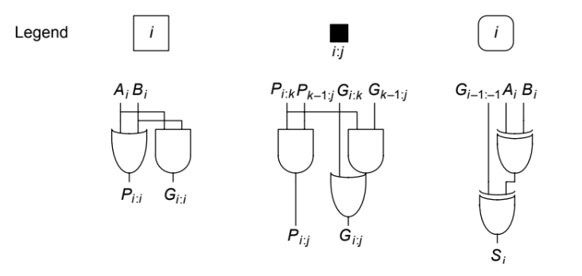
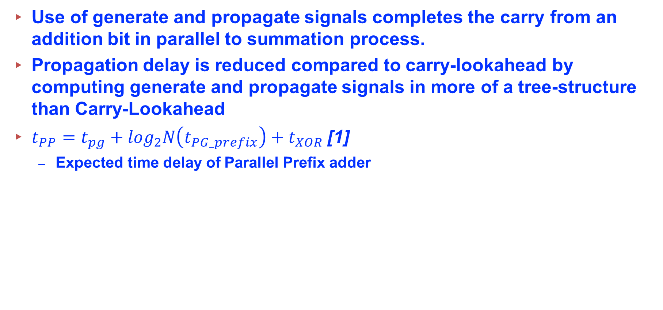
Techniques – Parallel Prefix (Sklansky)
Use of generate and propagate signals completes the carry from an addition bit in parallel to summation process.
Propagation delay is reduced compared to carry-lookahead by computing generate and propagate signals in more of a tree-structure than Carry-Lookahead
$t_{PP}=t_{pg}+\log_{2}N\left(t_{PG_prefix}\right)+t_{XOR}$[1]
Expected time delay of Parallel Prefix adder
Figure 5: 16-Bit Parallel Prefix Adder Legend [1]
Figure 4: 16-Bit Parallel Prefix Adder, Red lines denote critical path [1]

Slide 7
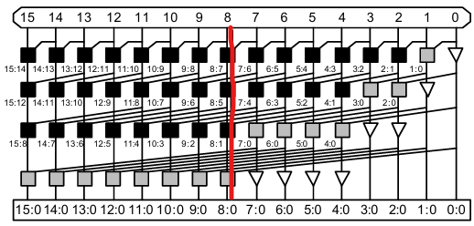
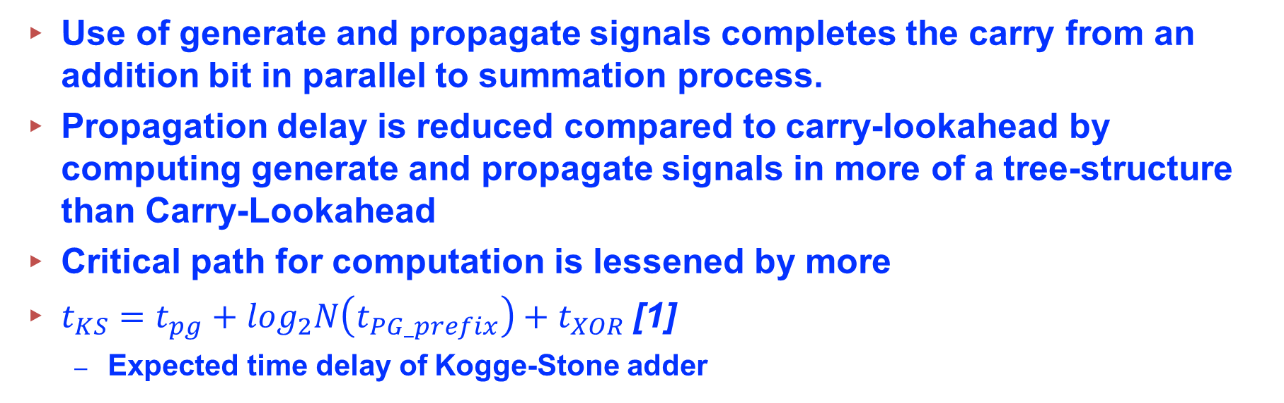
Techniques – Parallel Prefix (Kogge-Stone)
Use of generate and propagate signals completes the carry from an addition bit in parallel to summation process.
Propagation delay is reduced compared to carry-lookahead by computing generate and propagate signals in more of a tree-structure than Carry-Lookahead
Critical path for computation is lessened by more
$t_{KS}=t_{pg}+\log_{2}N\left(t_{PG_prefix}\right)+t_{XOR}$[1]
Expected time delay of Kogge-Stone adder
Figure 6: 16-Bit Kogge-Stone Adder, red is critical path [3]

Slide 8
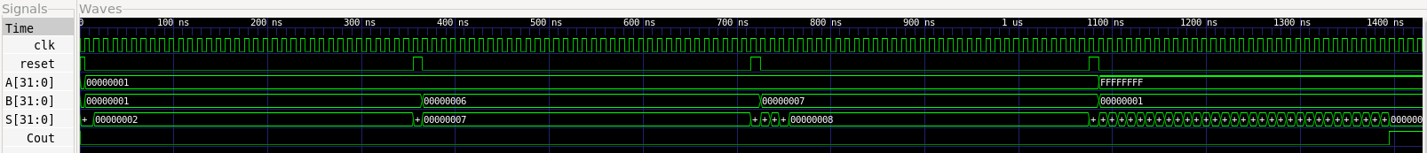
Results – Ripple Carry
Figure 7: Ripple Carry Adder GTK Waveforms
Test Cases
32’b 01+32’b 01
Final result occurs in 1-clock cycle
32’b 0110+ 32’b 01
Final result occurs after 1-clock cycle
32’b 0111+ 32’b 01
Final result obtained after 4-clock cycles
32’b 1+ 32’h FFFFFFFF(worst-case)
Final result obtained after 32-clock cycles

Slide 9
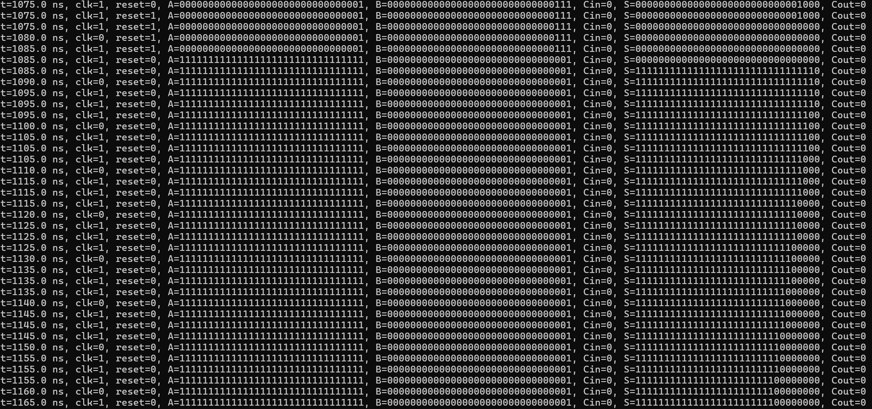
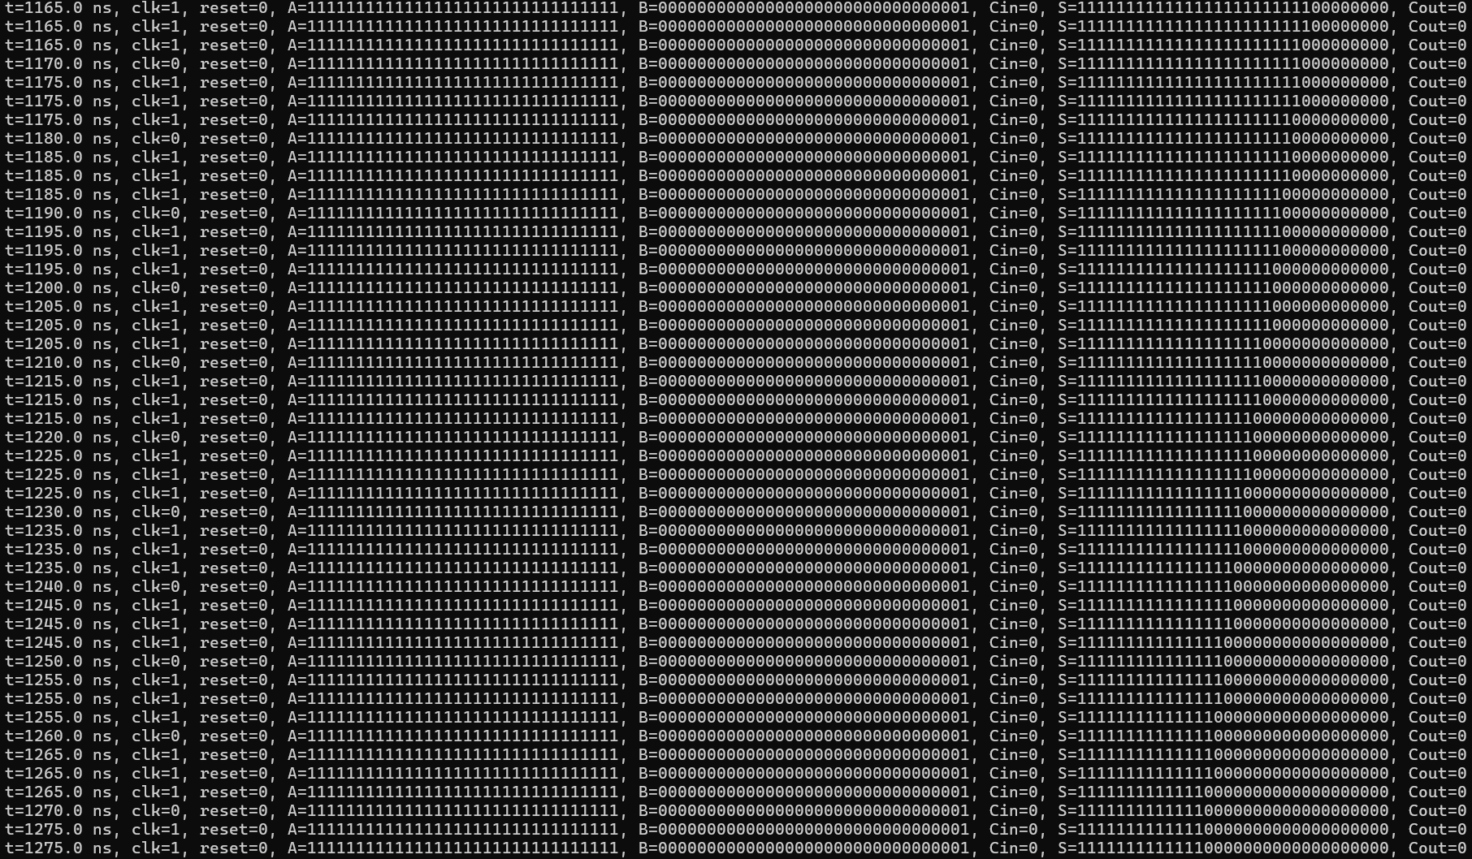
Results – Ripple Carry – Worst Case

Slide 10
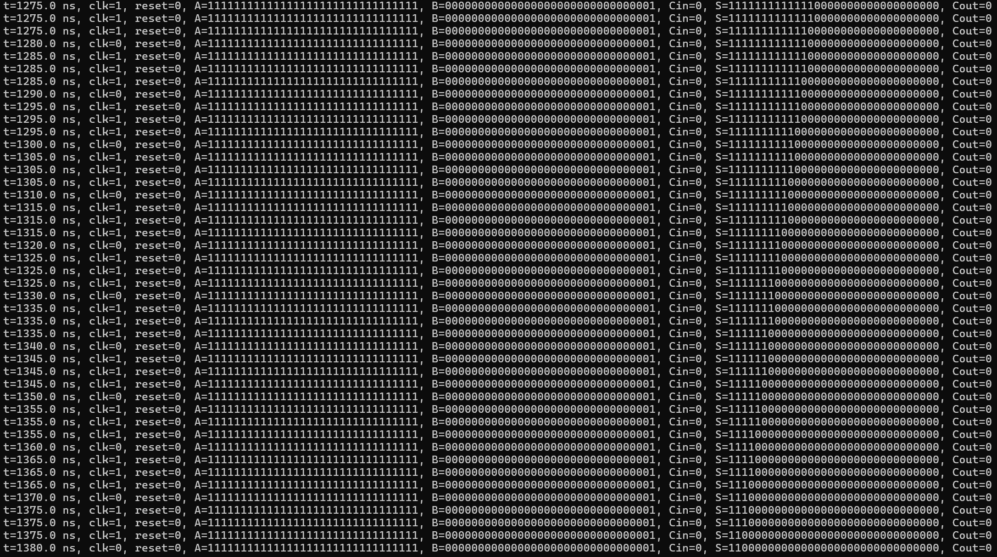
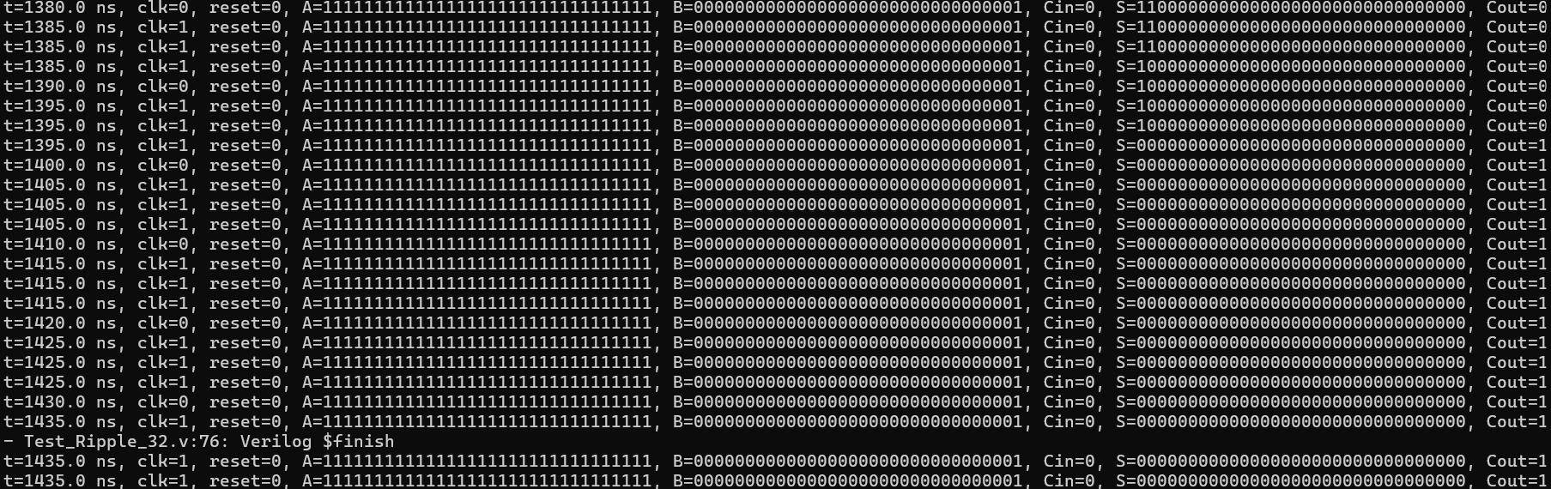
Results – Ripple Carry – Worst Case

Slide 11
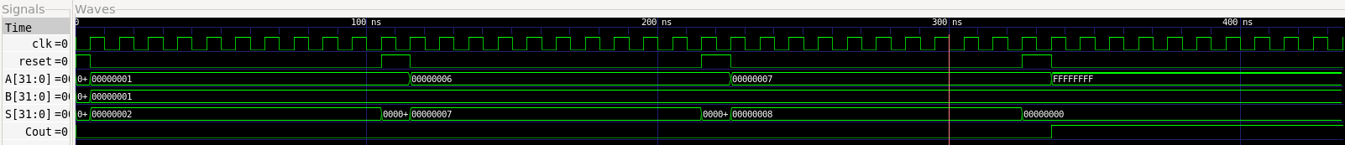
Results - CLA
Figure 8: Carry-Look Ahead Adder GTK Waveforms
Test Cases
32’b 01+32’b 01
Final result occurs in 1-clock cycle
32’b 0110+ 32’b 01
Final result occurs after 1-clock cycle
32’b 0111+ 32’b 01
Final result obtained after 1-clock cycles
32’b 1+ 32’h FFFFFFFF(worst-case)
Final result obtained after 1-clock cycles

Slide 12
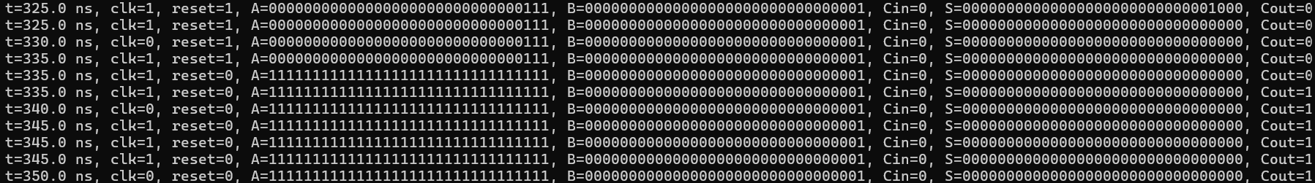
Results – CLA – Terminal Print Out

Slide 13
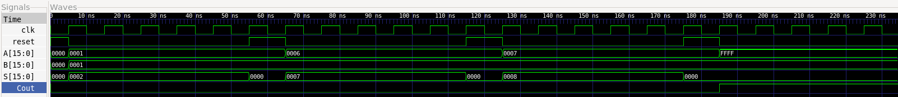
Results – Parallel Prefix
Figure 9: GTK Wave Output for Parallel Prefix
Test Cases
16’b 01+16’b 01
Final result occurs in 1-clock cycle
16’b 0110+ 16’b 01
Final result occurs after 1-clock cycle
16’b 0111+ 16’b 01
Final result obtained after 1-clock cycles
16’b 1+ 16’h FFFF(worst-case)
Final result obtained after 1-clock cycles

Slide 14
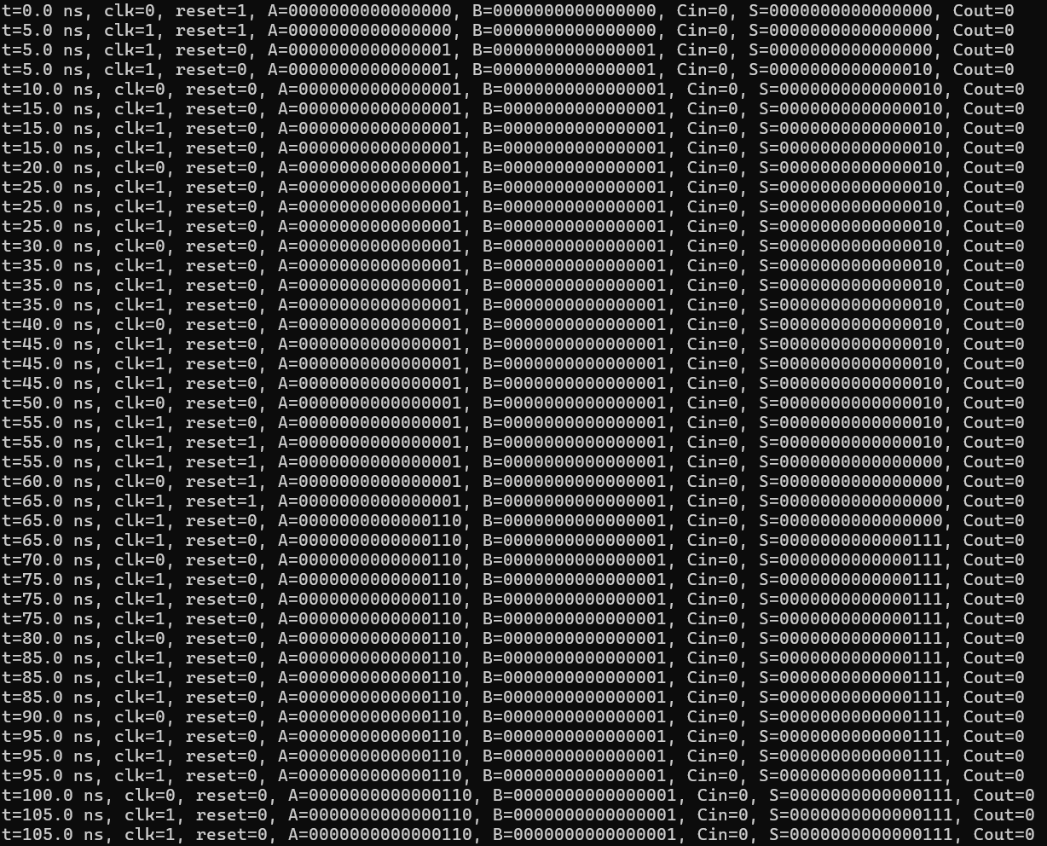
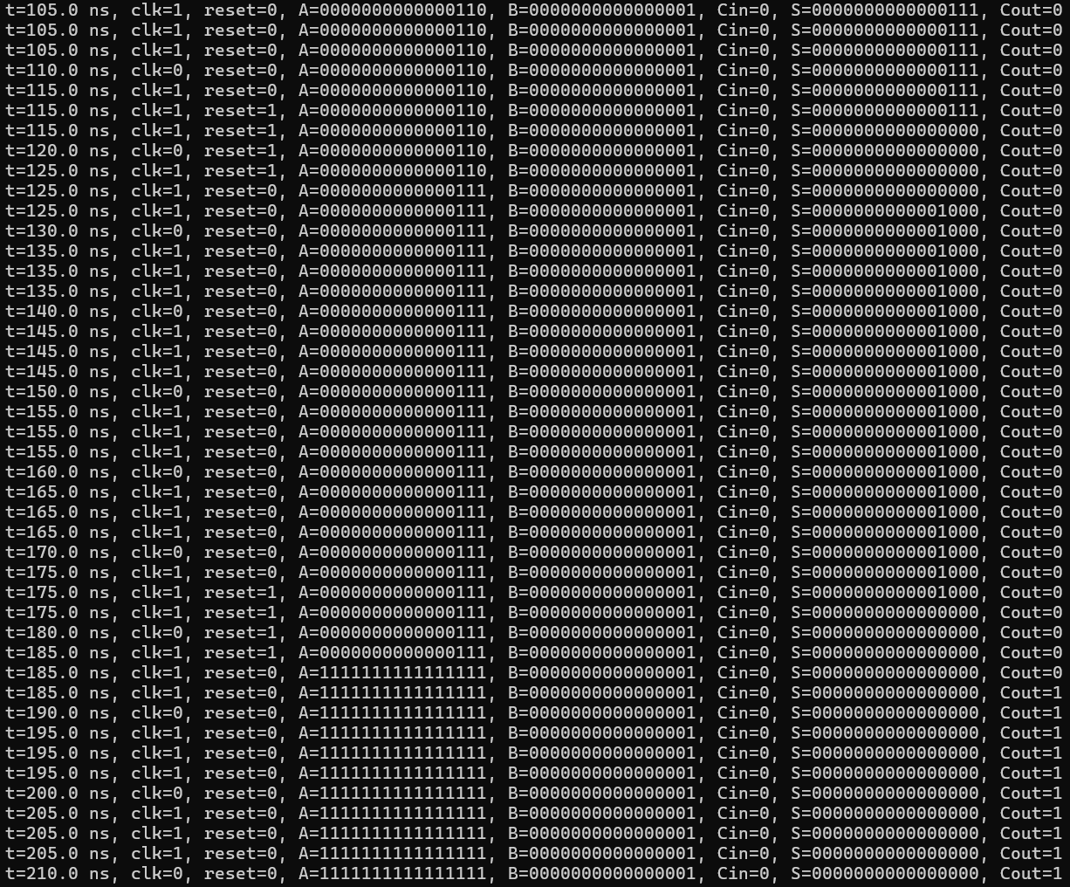
Results – Parallel Prefix – Terminal Print Out

Slide 15
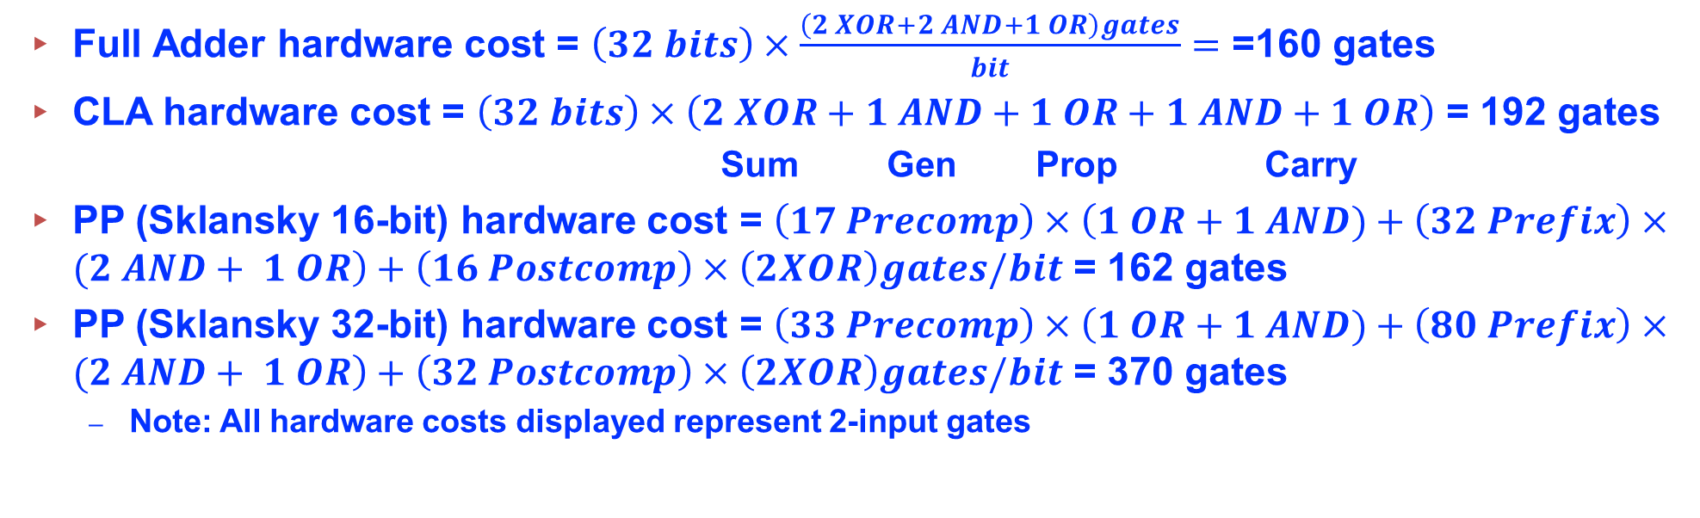
Results - Combined
Full Adder hardware cost = $\left(32 bits\right)×\frac{\left(2 XOR+2 AND+1 OR\right)gates}{bit}=$ =160 gates
CLA hardware cost = $\left(32 bits\right)×\left(2 XOR+1 AND+1 OR+1 AND+1 OR\right)$ = 192 gates
Sum Gen Prop Carry
PP (Sklansky 16-bit) hardware cost = $\left(17 Precomp\right)×\left(1 OR+1 AND)+\left(32 Prefix\right)×(2 AND+ 1 OR\right)+\left(16 Postcomp\right)×\left(2XOR\right)gates/bit$ = 162 gates
PP (Sklansky 32-bit) hardware cost = $\left(33 Precomp\right)×\left(1 OR+1 AND)+\left(80 Prefix\right)×(2 AND+ 1 OR\right)+\left(32 Postcomp\right)×\left(2XOR\right)gates/bit$ = 370 gates
Note: All hardware costs displayed represent 2-input gates
Adder Topology | Simulation Time (clock cycles) | Hardware Cost (number of gates) | Complexity (coding cost)
Ripple-Carry (32-bit) | 32 | 160 gates | LOW
Carry Look Ahead (32-bit) | 1 | 192 gates | MEDIUM
Parallel Prefix (16-bit) | 1 | 162 gates | HIGH
Table 1: Adder Topologies and Their Simulation Time, Hardware Cost, Coding Difficulty

Slide 16
Deviation From Expected Results
Expected the CLA adder to reach its final result after 4 clock-cycles, but the result was obtained in one.
This means the CLA may have been inadvertently created with 1-bit ripple carry blocks.
Adder Topology | Simulation Time (clock cycles) | Hardware Cost (number of gates) | Complexity (coding cost)
Ripple-Carry (32-bit) | 32 | 160 gates | LOW
Carry Look Ahead (32-bit) | 1 | 192 gates | MEDIUM
Parallel Prefix (16-bit) | 1 | 162 gates | HIGH
Table 1: Adder Topologies and Their Simulation Time, Hardware Cost, Coding Difficulty

Slide 17
Conclusion
Ripple-Carry
Slowest Adder in terms of simulation time (clock-cycles)
Lowest Hardware cost
Very easy to code
Carry-Lookahead
Tied for simulation time (clock-cycles), but propagation delay should be investigated more thoroughly to determine actual simulation time
Implementation in Verilog was harder than the Ripple-Carry, but easier than the parallel prefix (Sklansky)
Parallel-Prefix
Tied for simulation time (clock cycles) with CLA
Most difficult to implement in Verilog

Slide 18
References
[1] D. M. Harris and S. L. Harris, Digital Design and Computer Architecture, 2nd ed. San Francisco, CA, USA: Morgan Kaufmann, 2012. [2] “Full Adder Circuit,” Implement Logic, Aug. 16, 2011. [Online]. Available: https://implement-logic.blogspot.com/2011/08/full-adder-circuit_16.html.
[3] D. Harris, “A taxonomy of parallel prefix networks,” in Proc. IEEE Symposium on Computer Arithmetic, 2003.

